Slide 1

ILLINOIS INSTITUTE OF TECHNOLOGY
Analysis and Forecasting of Crime Rates in Chicago
2001-2016(2020)
By:-
Shivank Saxena A20388347
Group No - 187

Slide 2

OVERVIEW
Chicago being the capital city of crime in united states inspired me to choose this topic so that one can get the actual picture of crime rates, types of crimes, number of crime scene, location, and time which can in citizens and police to fight and prevent crime from happening.
As the data is mapped along the due course of time, we use Time Series Analysis to generate different models such as ARIMA, ARMA, AR, MA based on the historic data and compare them to predict future crime rates.

Slide 3
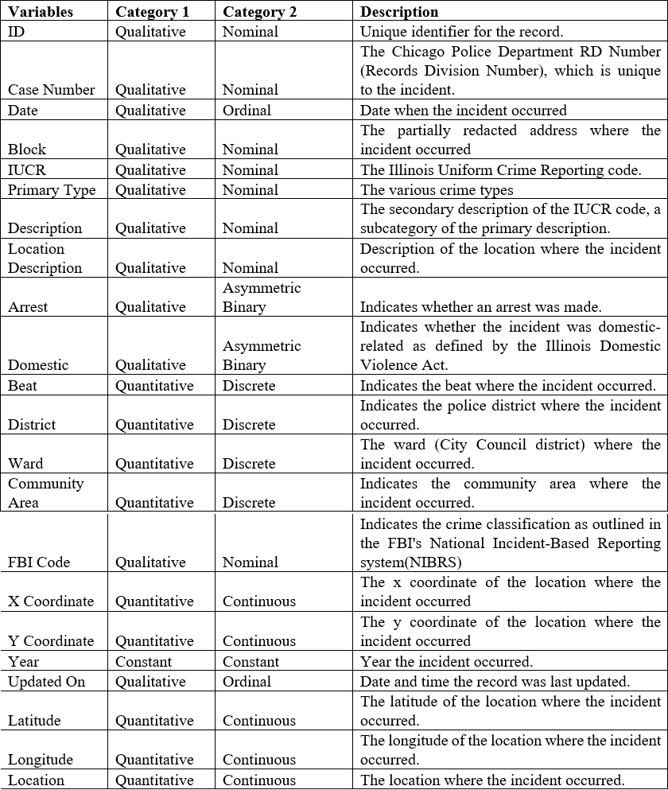
Information on Data Set
Dataset from Kaggle – “Crimes in Chicago”
Number of Observations – 62444
Total 22 Variable/factors
Case_Number considered to be as independent variable as it is unique for all observations.
Variables not used in analysis – Block, IUCR, District, Ward, FBI Code
The data is recorded according to the year, so year is considered to be constant.

Slide 4
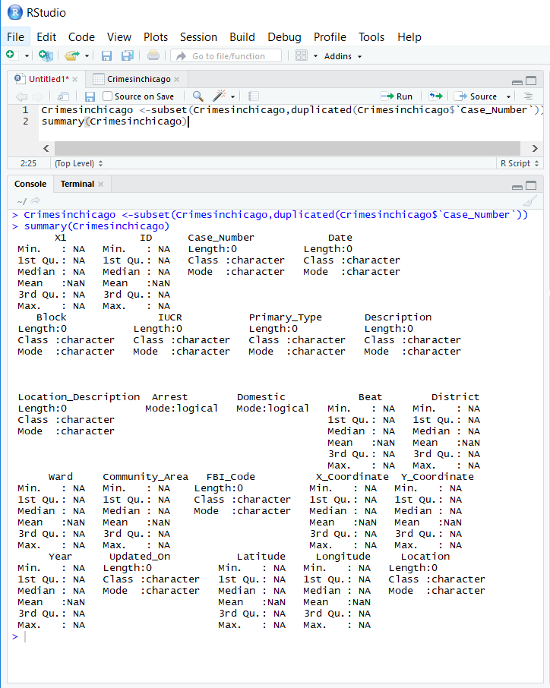
Data Cleaning
AS the observations are stored with a unique ID which is the Case Number in our dataset.
We look for the duplicate records and eliminate them by using combination of subset() and duplicated() function.
We also remove the missing records/Empty records which cannot be logically substituted in Excel.
Also due to incomplete records of year 2017, these records were removed

Slide 5

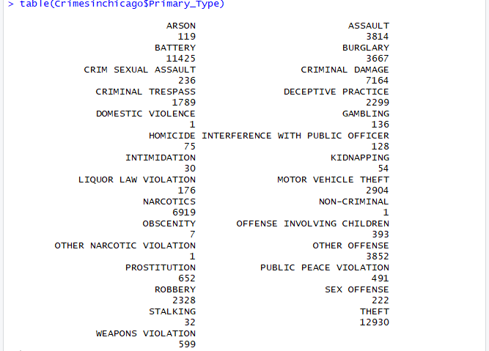
Types of Crime Analysis
Based on description, crime can be classified into following categories with each specifying the number.
The total types of crime are 29.
Some types of Crimes can also be combined together

Slide 6
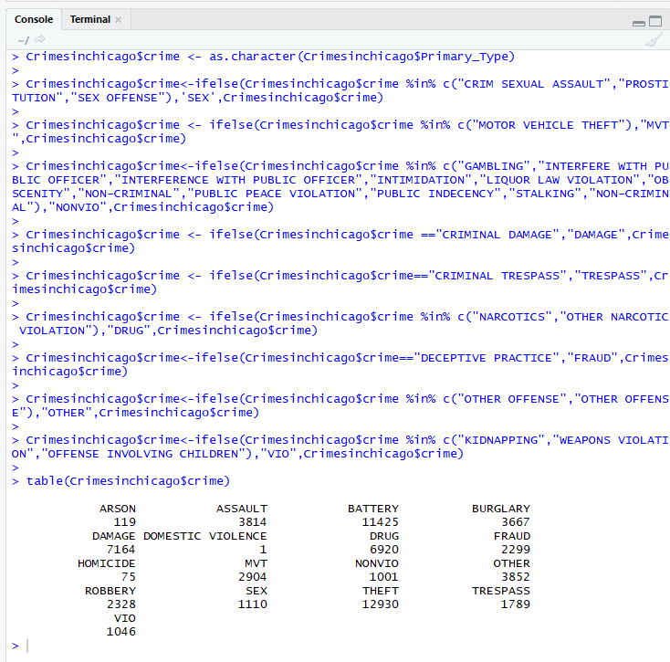
This helps in generalizing the crimes according to category

Slide 7
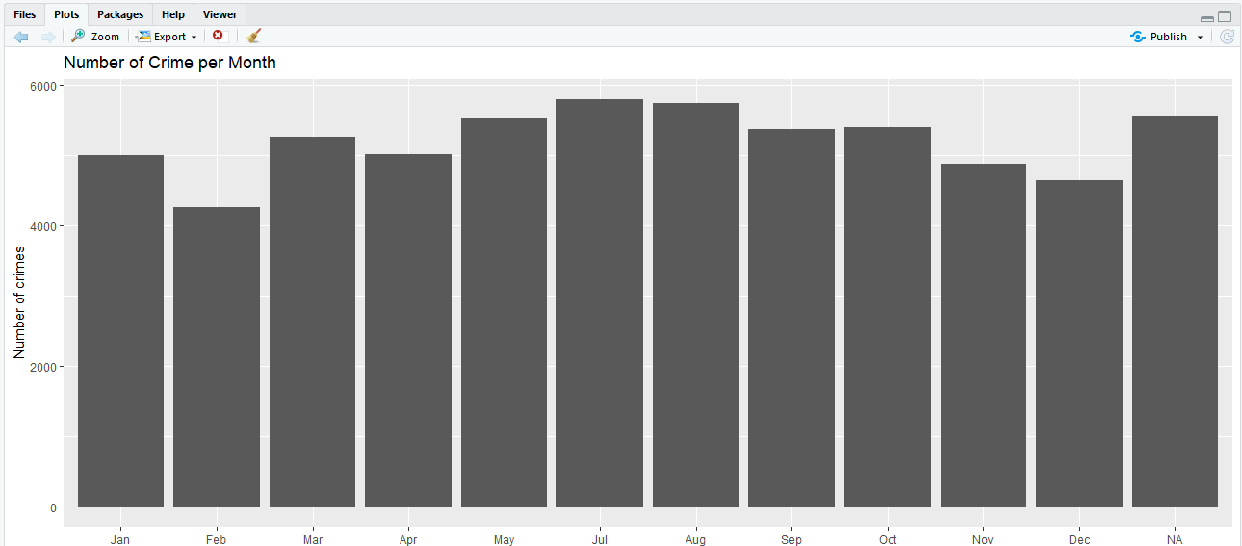
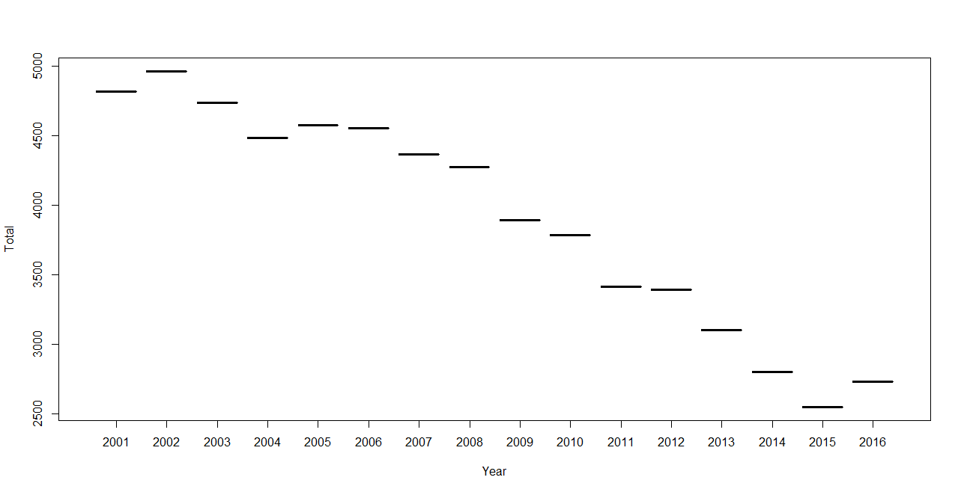
Hypothesis Testing
Let us assume that :
(1)Ho = Maximum crime happens in winter.
(2)Ho= Crime rate is increasing with years.
(3) Ho= Sunday is prone to maximum number of crimes.
(4) Ho= Domestic Violence has the highest crime number.
(1)
(2)

Slide 8
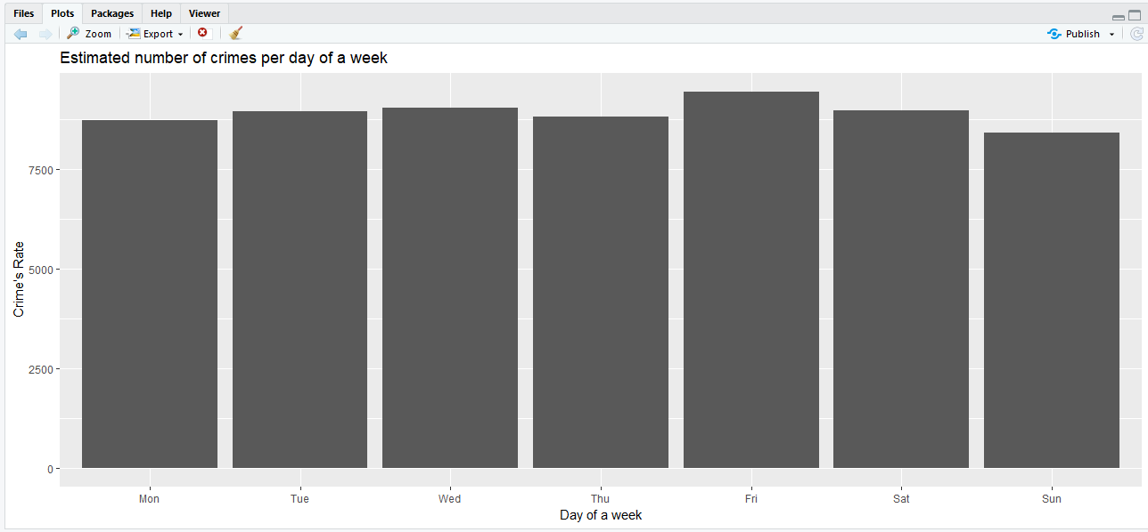
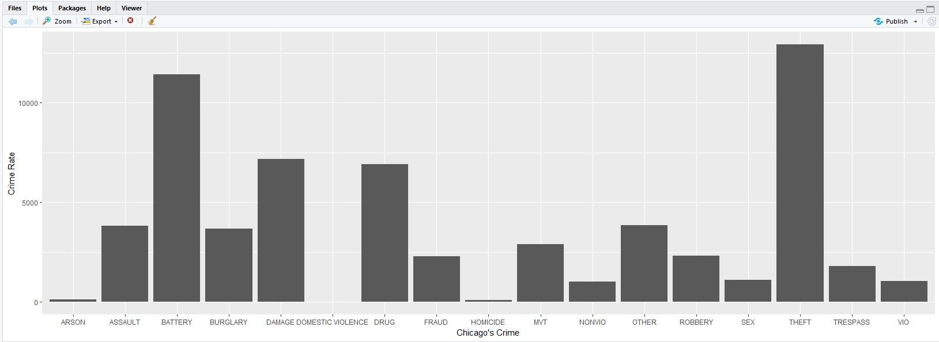
(3)
(4)
As we can see all the assumption made are false and no mean values could be determined for this data set therefore we reject null hypothesis testing.

Slide 9
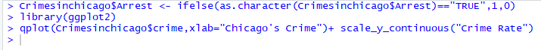
Determining the Frequency of Crime -Using different types of plots
Based on the type of crime
Using q Plot

Slide 10
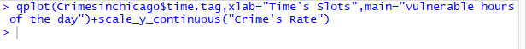
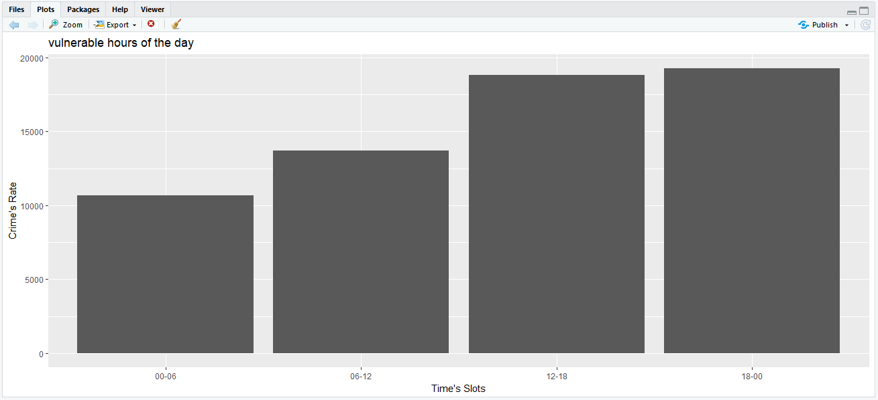
Based on the time zone
By splitting the time into 4 zone of 6 hours each.
Using q Plot

Slide 11
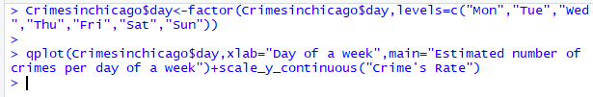
Based on days of a week
Using q Plot

Slide 12

Based on average Month basis
Using q Plot

Slide 13
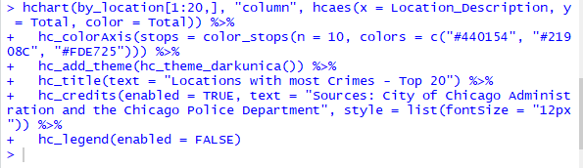
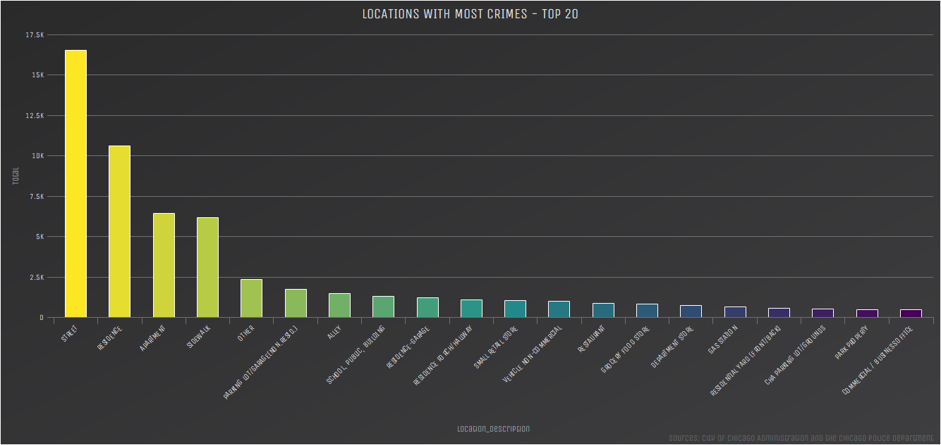
Based on Location
Using hchart
With condition of only top 20

Slide 14
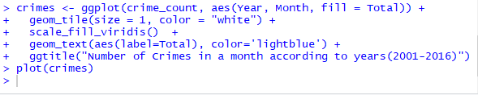
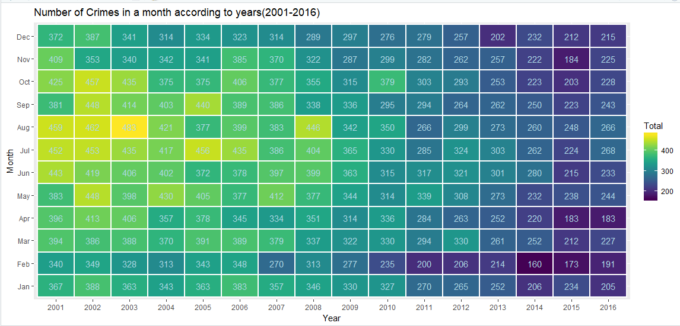
Based on per month of an year
Based on heatmap

Slide 15
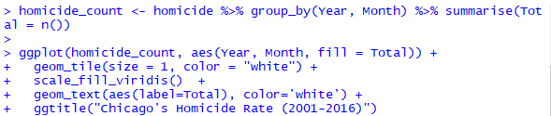
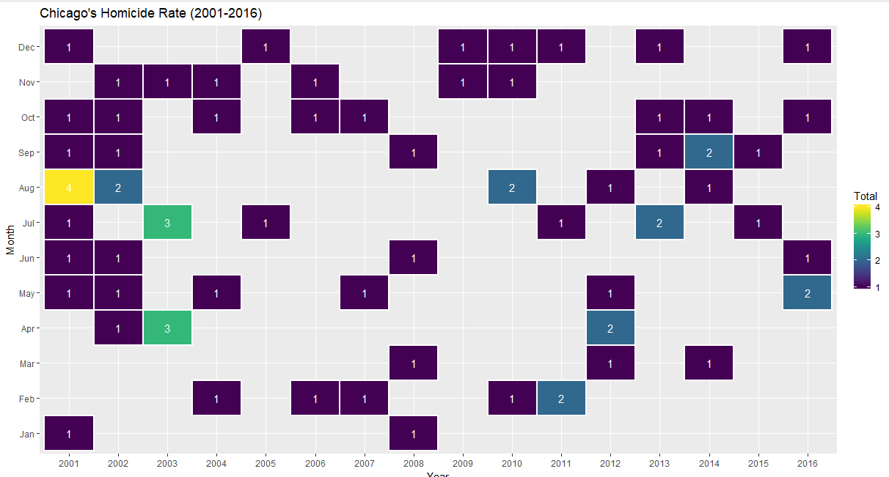
Based on homicide of an year
Using Heatmap

Slide 16
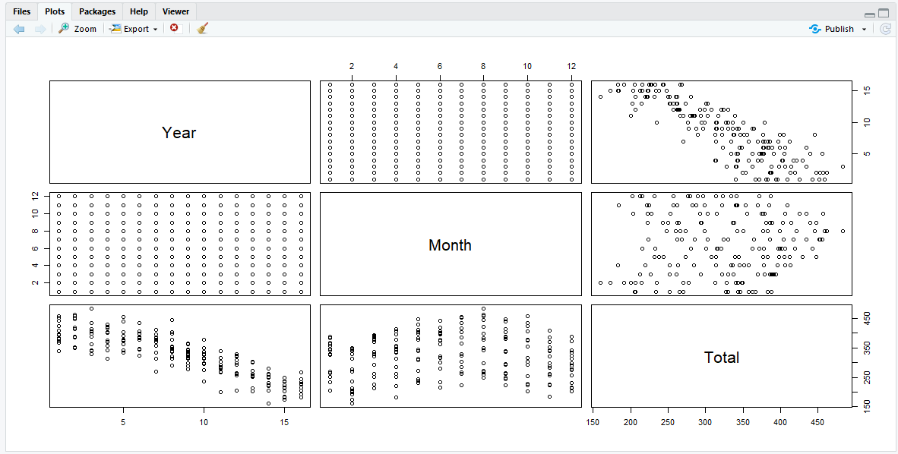
Scatter Plot for Crime Count

Slide 17
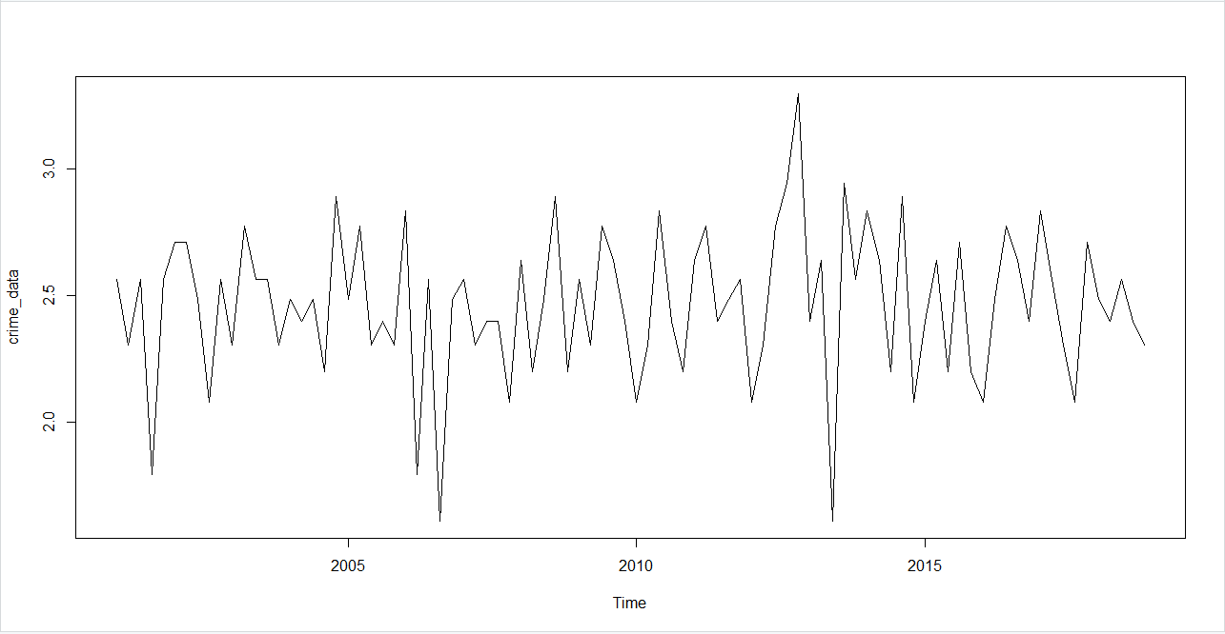
Plot of Time Series on yearly Data
For Checking of Data Stationarity
This shows that there is variation in mean and variance over time, We apply differencing

Slide 18
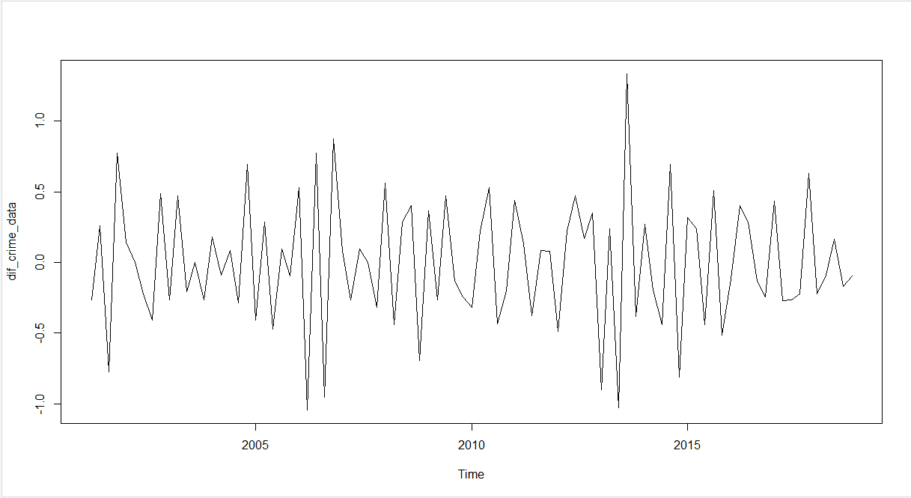
Plot After applying differencing
As we see the data is stationary and so does not require any more differencing
Therefore, we build Time Series Models

Slide 19
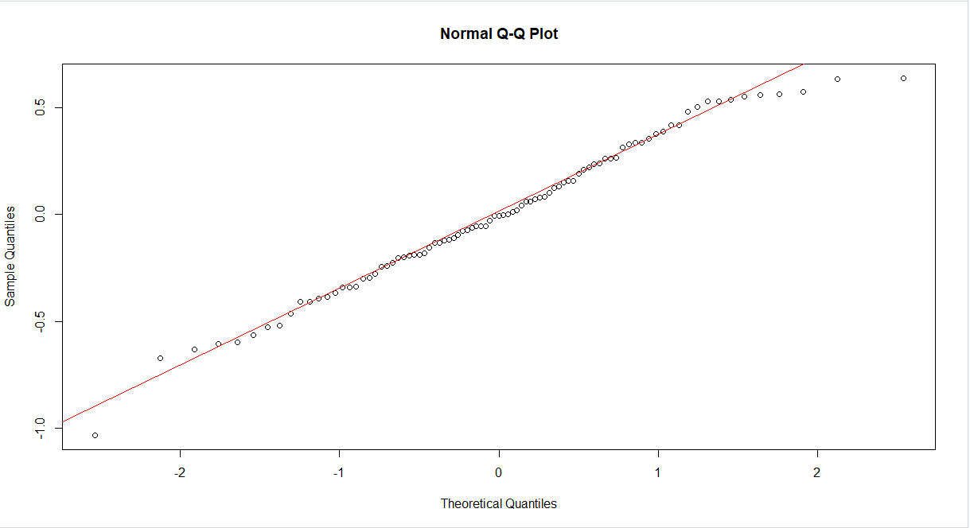
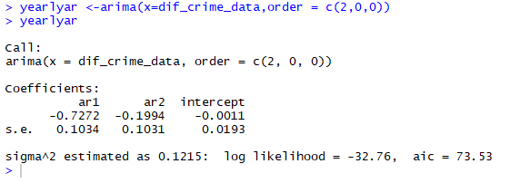
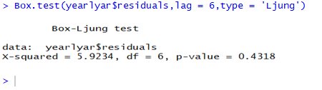
AR Model
Residuals follows normal distribution
At 95% confidence level, P value is greater than 0.05. Residuals are white noise

Slide 20
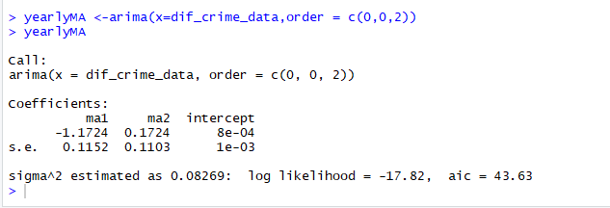
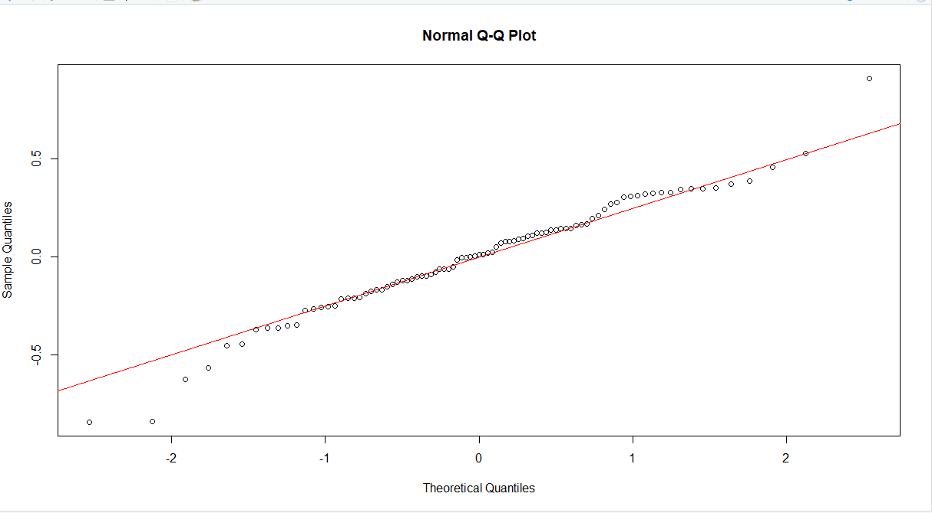
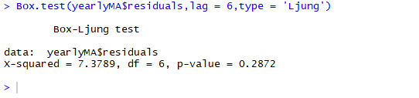
MA Model
Residuals follows normal distribution
At 95% confidence level, P value is greater than 0.05. Residuals are white noise

Slide 21
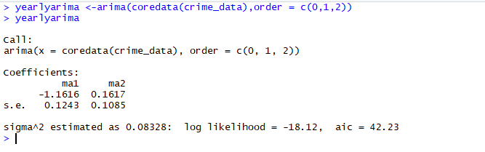
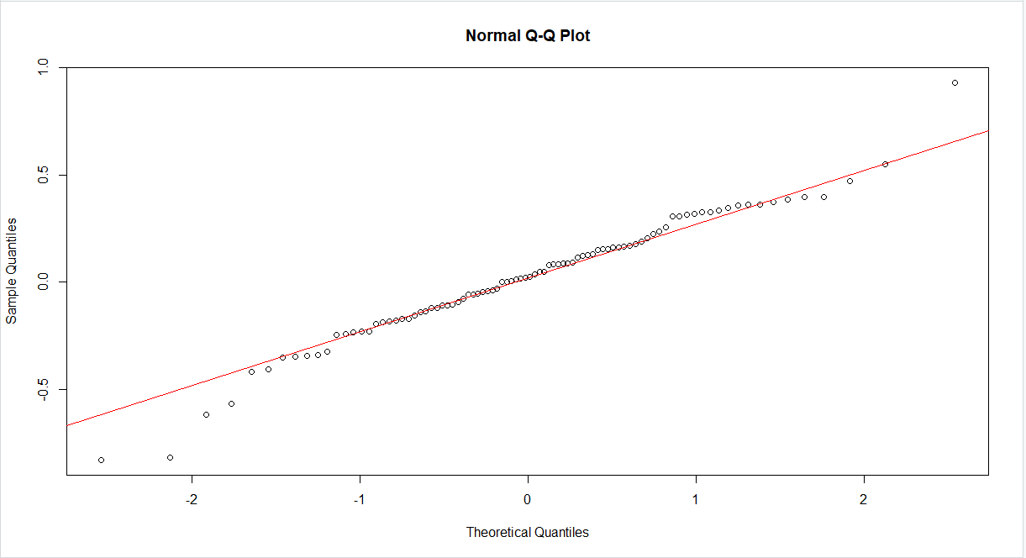
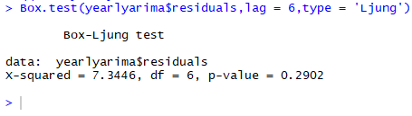
ARIMA Model
Residuals follows normal distribution
At 95% confidence level, P value is greater than 0.05. Residuals are white noise

Slide 22
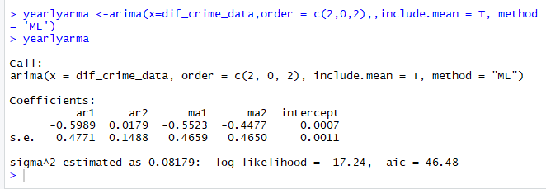
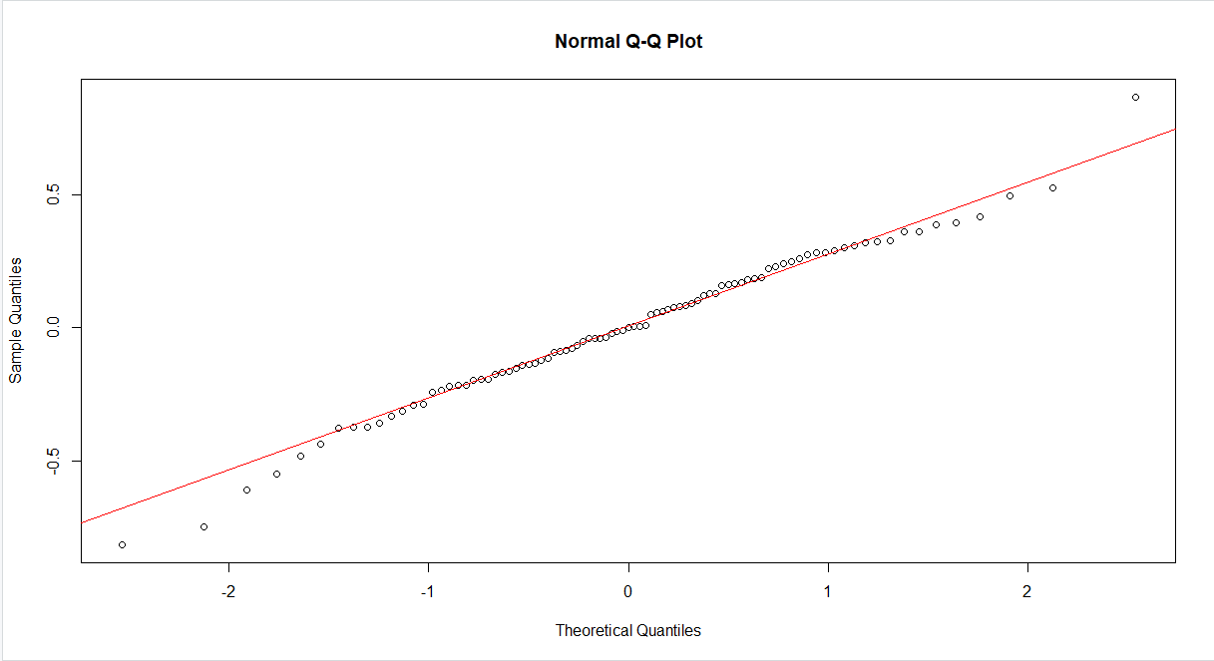
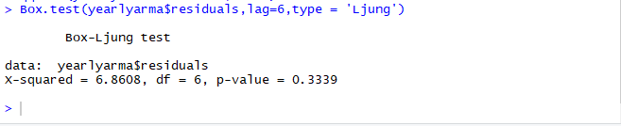
ARMA model
Residuals follows normal distribution
At 95% confidence level, P value is greater than 0.05. Residuals are white noise

Slide 23
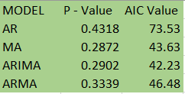
Model Results
P value for all the models is greater than 0.05
It can be concluded that residual is white noise which meets the assumptions in residual analysis.
Also, It can be proved again that the null hypothesis can be rejected as the value of p is less than 0.05 for all the models.
Using AIC value as the criteria, It can be said that ARIMA model is the best model with least AIC value.

Slide 24
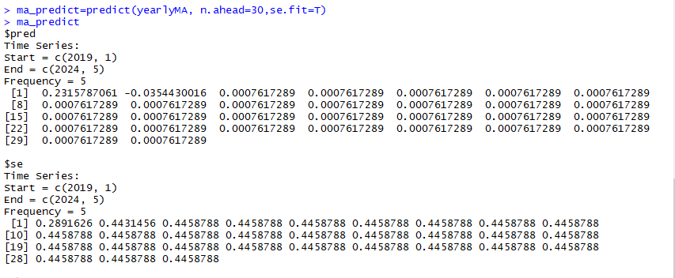
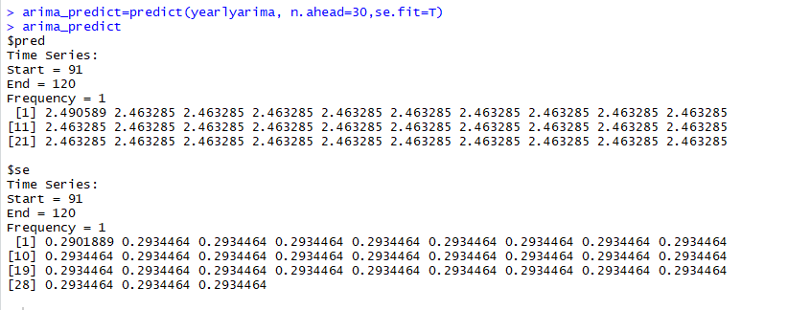
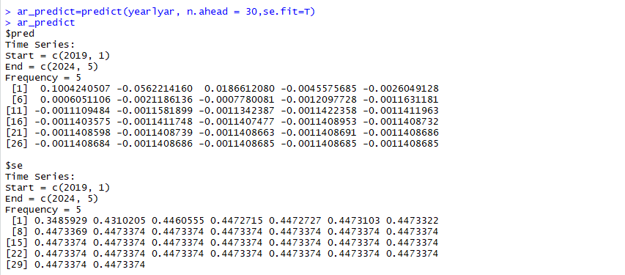
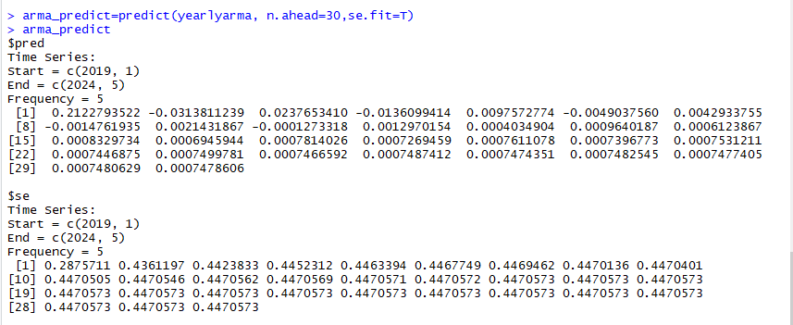
Predicting Values of Different Models
MA Model
ARIMA Model
AR Model
ARMA Model

Slide 25
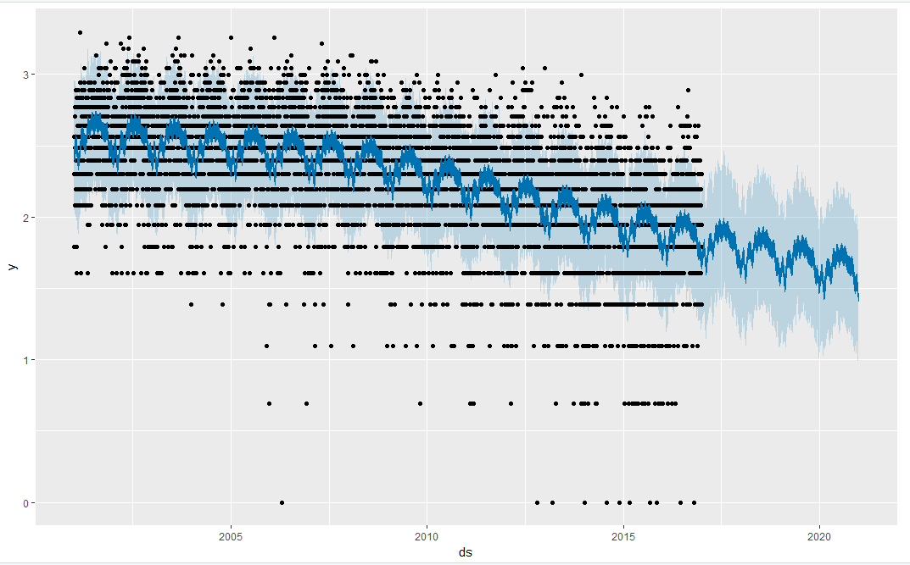
Forecast Prediction
Y axis = Differential Log value of crimes
X axis = Year
Analysis of Crime Data from 2001-2016
Prediction of Crime Data from 2017-2022
Black Dots – outliers
Light blue area – Possibility of crime
Dark blue area – Actual Crime Scene

Slide 26
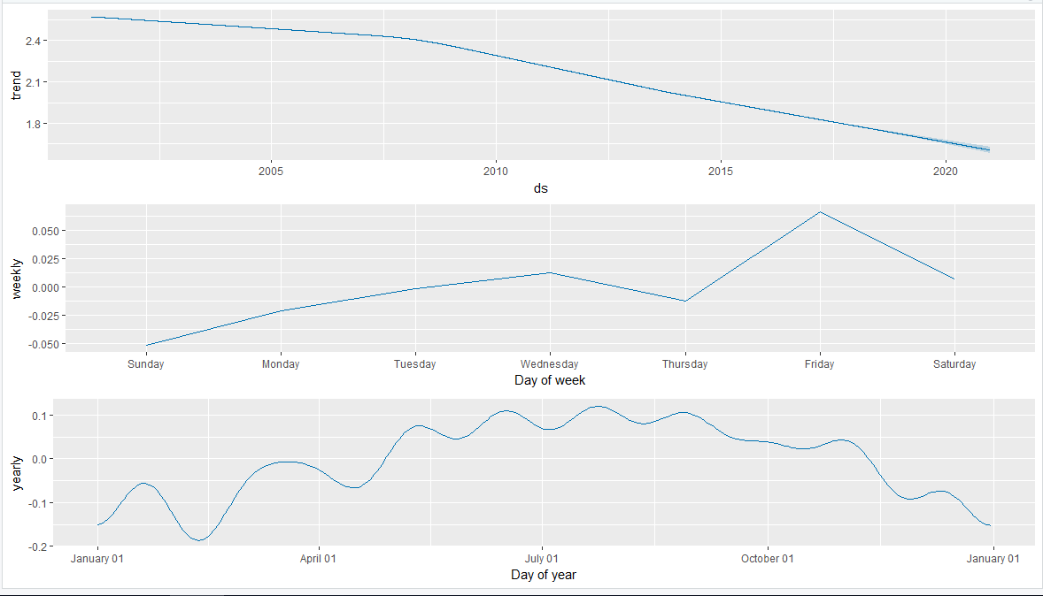
Forecast Plot
Results plotted on average basis
1st one Year vs number of crime log value
2nd one Day of Week vs Log value of number of crimes
3rd one Quarterly year vs log value of number of crimes

Slide 27
Forecast Results
Forecast results states that the crime rate would continue to decrease with enforcement of better law and order.
The number of Crimes would be remain comparatively high on Fridays.
While plotting the graph on quarterly basis, the graphs shows lot of variations whereas plotting it on yearly basis it becomes more stable.

Slide 28
Conclusion
Maximum number of Crime takes places during the months of summers specially in July, so people needs to be more careful during these months.
Crimes scenes usually takes place on local streets. So police should be more stringent in rules and regulations.
Evening time from 8 - 12 is most prone to criminal activities.
Most popular criminal activity is theft and burglary.
Homicides rates have again started increasing.

Slide 29
Future Implication
This can be extended on Node JS application using Python real time API.
Data set cleansing can be enhanced upon good available APIs.
The project can be further extended using datamining and data modelling techniques.

